Slide 1
Introduction to Filtering
(view in slide show mode)
Intel Confidential
Notes:
1

Slide 2
This presentation provides a brief overview of filtering and common filter operators. Filtering allows you to reduce the rows returned from a query to just what you need.
Use the arrows at bottom right of slides to advance slides or click the left mouse button to advance slides if there are no arrows

Slide 3
Agenda
Common Filter Operators
Filtering From a File
Multiple Conditions – AND/OR

Slide 4
Common Filter Operators
Lot | Operation | Date Entered Operation | Moved in | Movein Date | On Hold
D5147340 | 5072 | 4/13/2005 18:05 | N |  | Y
D5147360 | 5559 | 4/22/2005 3:11 | N |  | Y
D525T0F0 | 5775 | 6/13/2005 8:44 | N |  | N
D525T2D0 | 6615 | 6/16/2005 6:02 | Y | 6/16/2005 6:25 | N
Operation IN
(‘5072’ ,’5559’)
Operation
= ‘5072’
First, there is the basic equal (=) operator. The = operator lets you pull a single, exact value.
E.g., if we were to filter using operation = ‘5072’, which row would be selected? Click Next for the answer
This table shows sample data from a data source. Say I wanted to filter it to return data at a particular operation
The IN filter operator lets you pull up to one thousand elements.
If the filter criteria were for operation IN 5072 or 5559, which rows would be selected? Click Next for the answer
Notes:
4

Slide 5
Common Filter Operators
Lot | Operation | Date Entered Operation | Moved in | Movein Date | On Hold
D5147340 | 5072 | 4/13/2005 18:05 | N |  | Y
D5147360 | 5559 | 4/22/2005 3:11 | N |  | Y
D525T0F0 | 5775 | 6/13/2005 8:44 | N |  | N
D525T2D0 | 6615 | 6/16/2005 6:02 | Y | 6/16/2005 6:25 | N
Lot LIKE
‘D525%’
Lot LIKE
‘D5__T%’
Then there is the LIKE filter operator. LIKE lets you do pattern matching. The wildcards are the percent sign (%) and the underscore (_). % is a general wild card that lets you substitute any characters of any length (i.e., 0 or more characters). _ is a single character wildcard that lets you substitute any single character. Note that the LIKE LIST operator lets you filter by multiple patterns
The underscore (_) lets you substitute a single character. E.g., filter expression Lot Like ‘D5 __ T%’ means pull all lots that start with D5 and which contain a T in position 5. In addition, positions 3 and 4 of the lot may store anything and the remainder of the lot string after position 5 is wild. For this case, which rows in the table would be selected? Click Next to see the answer.
So, if you wanted to pull all lots that start with D525, the filter criteria would be Lot LIKE ‘D525%’ . For this filter criteria, which rows in the table would be selected? Click Next to see.

Slide 6
Common Filter Operators
Date Entered Operation
Between
13-Jun-2005 00:00:00 AND
17-Jun-2005 00:00:00
AND Moved in = ‘Y’
Lot | Operation | Date Entered Operation | Moved in | Movein Date | On Hold
D5147340 | 5072 | 4/13/2006 18:05 | N |  | Y
D5147360 | 5559 | 4/22/2006 3:11 | N |  | Y
D525T0F0 | 5775 | 6/13/2005 8:44 | N |  | N
D525T2D0 | 6615 | 6/16/2005 6:02 | Y | 6/16/2005 6:25 | N
Date columns generally also contain a time component so searching using In and = filter operators are generally not useful. When filtering on dates, you typically use range search operators such as >=, >, <=, < or Between.
Say we wanted to search for dates Between June 13th at midnight and June 17th at midnight. In addition, say we also wanted to filter on rows where the Moved In Date is equal to Y. Which rows in the table would be selected? Click Next for the answer
Notes:
6

Slide 7
Agenda
Common Filter Operators
Filtering From a File
Multiple Conditions – AND/OR

Slide 8
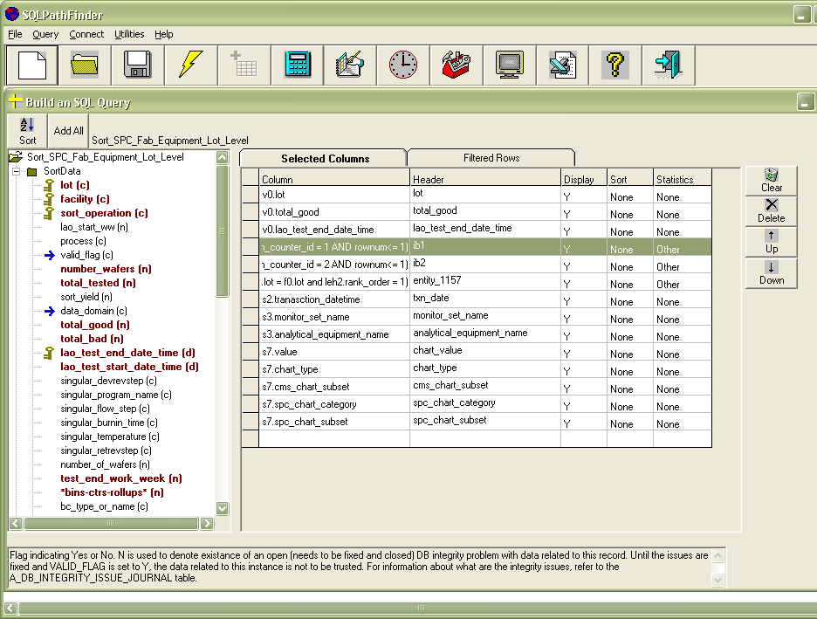
Filtering From a File
SQLPathFinder also allows you to search by items in a file using either the IN GROUP or the LIKE GROUP filters.
In Group
LOT, OPERATION,…
F6230001, 0200
F6230002, 0300
F6230003, 0400
Searches a column
in a CSV file with
headers. For Script
Host, dynamically
reads at run-time
Like Group
In Group (LIKE;=)
LOT, OPERATION,…
F6230, 0200
F623%, 0300
F6__0003, 0400
In Group (=;=;=N)
.
.
LOT, OPERATION,…
F6230001, 0200
F6230002, 0300
F6230003, 0400
Searches “column” with
wild cards in a CSV file
with headers.
Searches multiple “columns” in a CSV file, using multiple search operators

Slide 9
SQLPathFinder also lets you search by the combination of columns in a text file using special In Group search operators. This will not be covered in this course, however.
IN GROUP searches by values in one column of a comma or Tab delimited file. The file must contain column headers. Below, column 1 in the file is the Lot number, & we can search for lots that match column 1
LIKE GROUP lets you search for data in a file which may contain wild cards % & _ in one of its columns. Recall that % substitutes for zero or more characters & _ substitutes for one character
E.g., this file has columns lot & Operation. Let’s say we want to search for Lots LIKE data in column 1. For the first row in the file, there is no wild card, so SQLPathFinder assumes the % wildcard is at the end, & looks for all Lots that start with F6230.
For the second row, SQLPathFinder will look for all Lots starting with F623, and for the third row, it will find Lots that begin with F6, that end with 0003, and are wild in positions 3 and 4.
In Group
LOT, OPERATION,…
F6230001, 0200
F6230002, 0300
F6230003, 0400
Searches a column
in a CSV file with
headers. For Script
Host, dynamically
reads at run-time
Like Group
In Group (LIKE;=)
LOT, OPERATION,…
F6230, 0200
F623%, 0300
F6__0003, 0400
In Group (=;=;=N)
.
.
LOT, OPERATION,…
F6230001, 0200
F6230002, 0300
F6230003, 0400
Searches “column” with
wild cards in a CSV file
with headers.
Searches multiple “columns” in a CSV file, using multiple search operators

Slide 10
Agenda
Common Filter Operators
Filtering From a File
Multiple Conditions – AND/OR

Slide 11
Multiple Conditions-AND/OR
To apply two or more filter conditions, use either the AND or the OR clause
AND | Both conditions must be met
OR | Either condition can be met
The AND and OR clauses connect multiple search conditions. AND implies that all conditions must be met. OR implies that either condition can be met.

Slide 12
Multiple Conditions-AND/OR
When specifying three or more filter conditions, AND takes precedence over OR, unless parentheses are used
A AND B OR C | A and B must be true or C must be true
A AND (B OR C) | A must be true AND either B or C must be true
Note that the AND clause always takes precedence over the OR clause. Hence A AND B OR C implies that A and B must be true or C on its own must be true.
One may use parentheses to override precedence. Hence the expression A AND ( B OR C) implies that A must be true AND either B or C must be true.

Slide 13
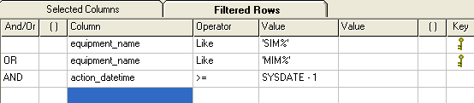
Multiple Conditions-AND/OR
Here, we are pulling data for equipment that start with either SIM or MIM and that processed WIP in the last 24 hours (i.e., SYSDATE or current date & time minus one day.) No parentheses are used in the expression. If today is October 6th, 2008, which rows from bottom table will be selected?
Since there are no parentheses in the expression, AND takes precedence over OR, and data is pulled for MIM tools that were processed in the last day and for all SIM tools regardless of when they processed WIP.
Today = 10/6/2008
Equipment_Name | Action_Datetime
SIM101 | 10/3/2008
SIM102 | 10/5/2008
MIM101 | 10/3/2008
MIM102 | 10/5/2008

Slide 14
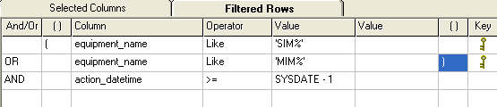
Multiple Conditions-AND/OR
Today = 10/6/2008
This query pulls data where the equipment starts with either SIM or MIM and where all tools processed WIP in the last day.
Equipment_Name | Action_Datetime
SIM101 | 10/3/2008
SIM102 | 10/5/2008
MIM101 | 10/3/2008
MIM102 | 10/5/2008
For this case, parentheses bounds the equipment filters. As such, which rows from bottom table will be selected?

Slide 15
Final Quiz!
Following are a few questions on the use of keys. You are allowed several chances to answer a question correctly. So relax and have fun! ☺
Intel Confidential

Slide 16
Quiz
Question 1 – Multiple Choice
Which filter operator allows you to search by multiple values, such as a list of three specific operation numbers? Click the correct button below.
=
LIKE
IN
BETWEEN
Intel Confidential
Notes:
16

Slide 17
Quiz
Question 2 – Multiple Choice
Which search operator would let me search by all entities that start with PLM or HME?
=
LIKE LIST
IN
BETWEEN
Intel Confidential
Notes:
17

Slide 18
Quiz
Question 3 – Multiple Choice
Which search operator allows you to filter on a lot list in a Comma or Tab separated values file?
LIKE LIST
IN GROUP
IN
BETWEEN
Intel Confidential
Notes:
18

Slide 19
Quiz
Question 4 – Multiple Choice
What would the expression Product Like 8PN_T% return?
All products equal to string 8PN_T%
All products that contain the string 8PN and
have a T somewhere in the expression.
All products that start with 8PN, that have a
T in the 5th position, and contain 0 or more
Characters after the T.

Slide 20
Quiz
Question 5 – Multiple Choice
What does the Like Group search operator allow you to do? Choose the option that is incorrect?
Lets you filter values in a file containing
the wildcards % or _
Allows you to search using multiple columns
in a file
If wildcards are not specified in the search
column, applies a starting with search on the
column values

Slide 21
Quiz
Question 6 – Multiple Choice
What does the filter expression Lot = ‘123’ AND Operation = ‘456’ OR Operation = ‘789’ without parentheses do?
Returns data for Lot 123 at operation 456 as
well as data for Lot 123 at Operation 789
Returns data where the lot equals to 123 and
its operation is 456, and also returns data for
all lots at operation 789.

Slide 22
That concludes the presentation
on Filtering Data
Intel Confidential

